Slide 1
XAMARIN
Nhóm 6:
- Trịnh Minh Đương
- Trịnh Kim Cơ

Slide 2
Giới thiệu
Xamarin thành lập năm 2011
Microsoft mua lại vào 11/2013
Chính thức phát hành tại Việt Nam vào 18/4/2014
Objective-C
Xcode
Java
Android Studio
#
Visual Studio
Notes:
Multiple Teams
Multiple Code Bases
Expensive & Slow
Positive = Great apps delivered to user’s platform
Negative = Development hampered by multiple code bases & fragmentation

Slide 3
iOS
Android
Windows
Objective-C
Xcode
Java
Android Studio
C#
Visual Studio
Không thể share code • Viết trên nhiều ngôn ngữ • Nhiều teams
Notes:
Multiple Teams
Multiple Code Bases
Expensive & Slow
Positive = Great apps delivered to user’s platform
Negative = Development hampered by multiple code bases & fragmentation

Slide 4
Write Once, Run Anywhere
Lua
Javascript
Actionscript
HTML+CSS
App Generator
Limited native API access • Slow performance • Poor user experience
Notes:
Unhappy Users
Unhappy Developers
Increase in Abandoned Apps
Limited to what is implemented

Slide 5
Xamarin’s Unique Approach
iOS C# UI
Android C# UI
Windows C# UI
Shared C# Mobile
Shared C# codebase • 100% native API access • High performance
Notes:
UI build natively per platform, leveraging C#
C# + XAML
C# + XML
C# + XIB
One shared app logic code base, iOS, Android, Mac, Windows Phone, Windows Store, Windows

Slide 6
Xamarin + Xamarin.Forms
iOS C# UI
Android C# UI
Windows C# UI
Shared UI Code
Shared C# Backend
Shared C# Backend
Traditional Xamarin Approach
With Xamarin.Forms: More code-sharing, all native
Notes:
Xamarin recently introduced Xamarin.Forms a new library for cross platform user interface. We will touch up on this later, but this enables you to be highly productive, share code, but build out UI on each platform and access platform APIs.
With Xamarin.Forms you now have a nice Shared UI Code layer, but still access to platform APIs
You can start from native, pick a few screens, or start with forms, and replace with native later

Slide 7
Xamarin’s Unique Approach
iOS C# UI
Android C# UI
Windows C# UI
Azure
Linux/Mono
CoreCLR
Shared C# Mobile
C# Server
Shared C# Client/Server
Shared C# codebase • 100% native API access • High performance
Notes:
With Xamarin it just isn’t your front end in C# it is your full backend server as well. With Azure or even on Linux running Mono or the CoreCLR your app is fully C# end to end!

Slide 8


Slide 9

Open Source
Xamarin.iOS
Xamarin.Mac
Xamarin.Android
Xamarin.Forms

Slide 10
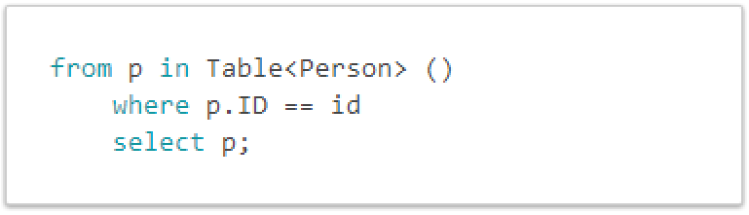
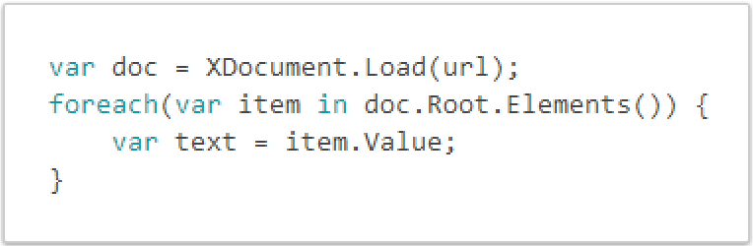
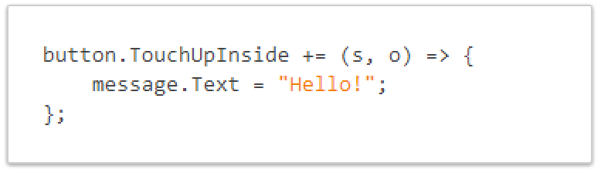
C# is Awesome
LINQ Support
Work with XML Easily
Event Handling & Delegates

Slide 11
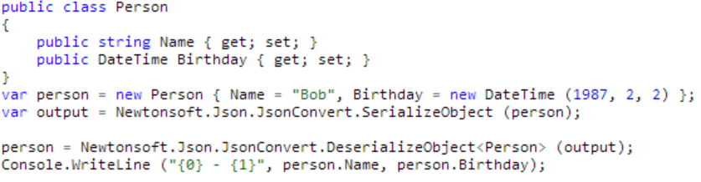
JSON Made Easy
Json.NET offers simple conversations to/from JSON strings and .NET objects:
Notes:
Use your favorite libraries like Json.NET!

Slide 12
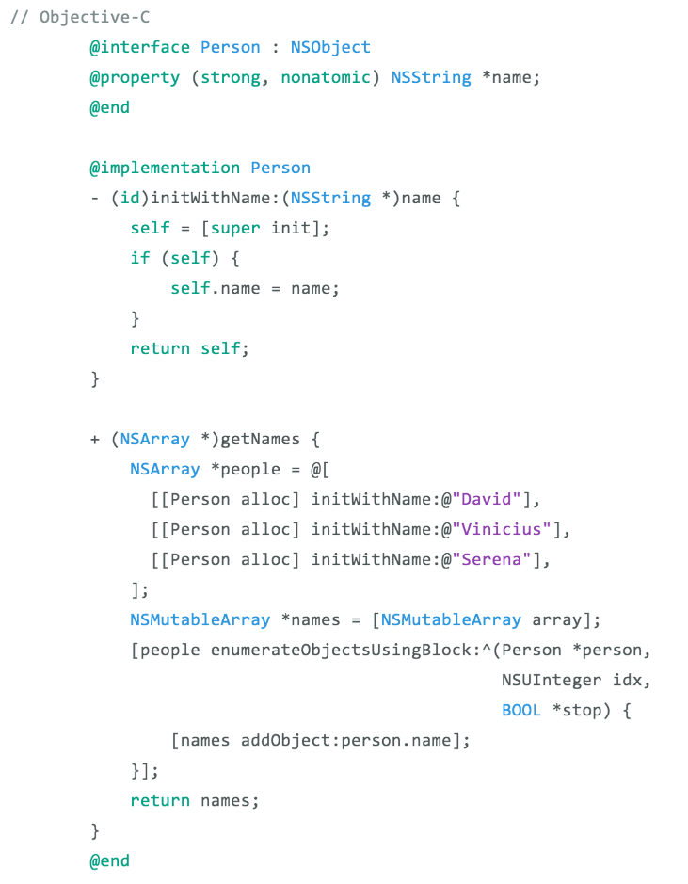
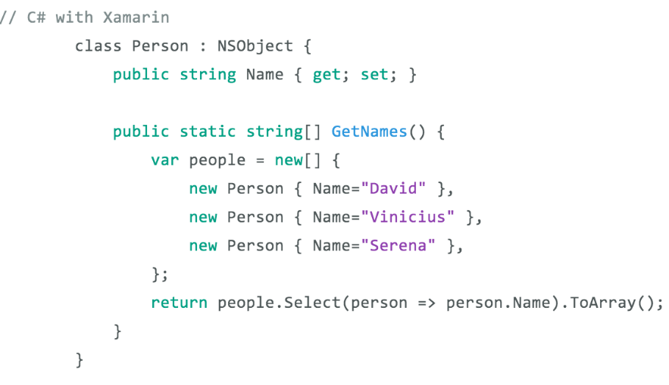
See the Different – Classes & Methods
Notes:
Here is an example of creating a class with a method to get names
1 Line with LINQ to execute this command
Take advantage of C# features and set properties easily

Slide 13
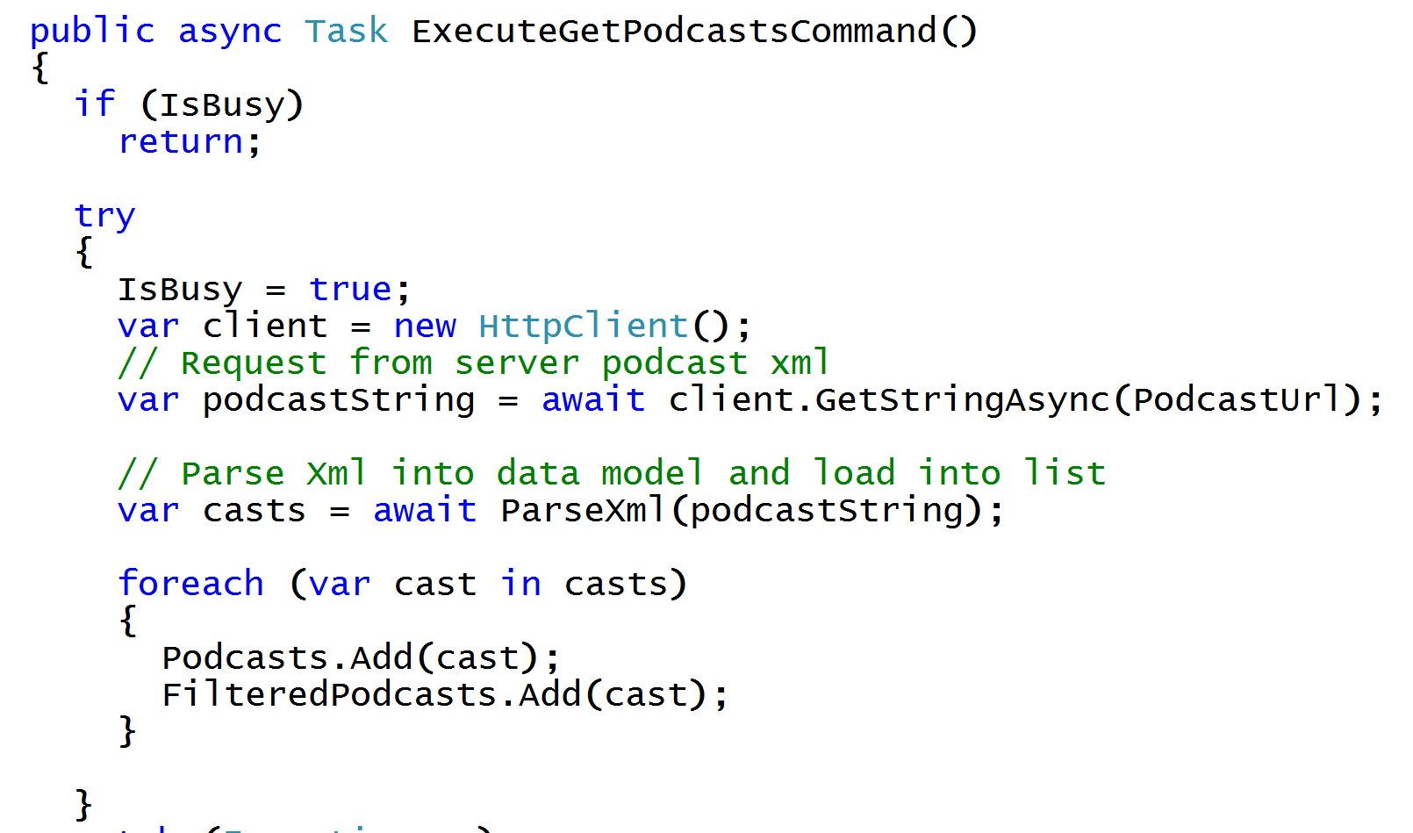
Async/Await
Write Beautiful & Maintainable Code
Notes:
The async and await keywords in C# 5.0 now available to Xamarin developers make asynchronous programming incredibly pleasant.
You end up with code that is much more linear and much easier to understand.
The compiler does a lot of magic for you which simplifies your code and your life.

Slide 14
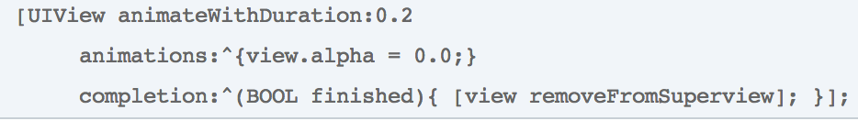
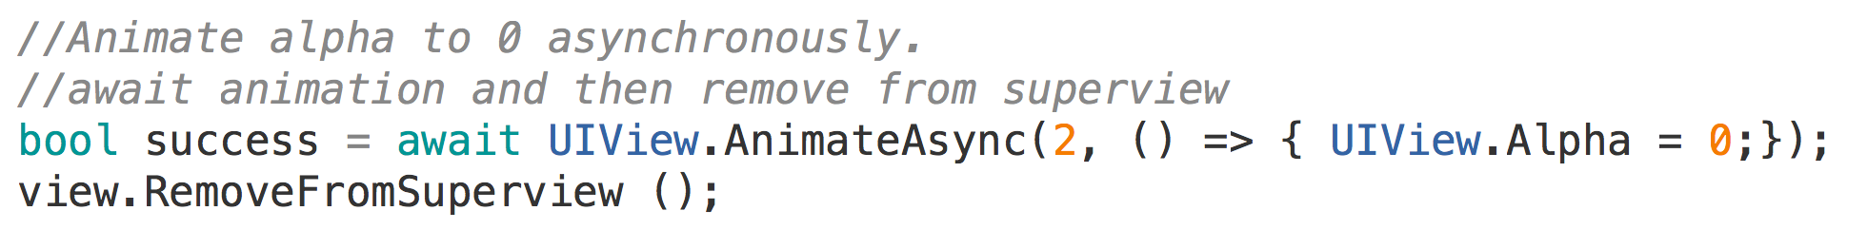
Simplifying Native Methods with Async/Await
Objective-C
C# with Xamarin
Notes:
With Xamarin we even extend native methods with C# Features
Here there is no need for a callback block, simply await on the animation to finish before continuing on

Slide 15
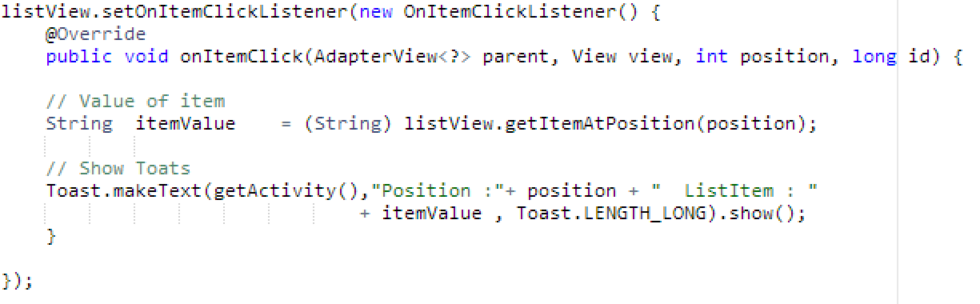
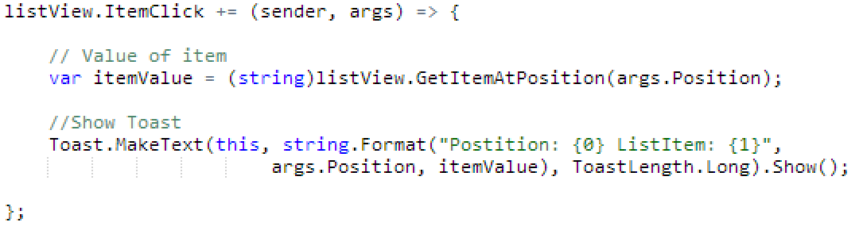
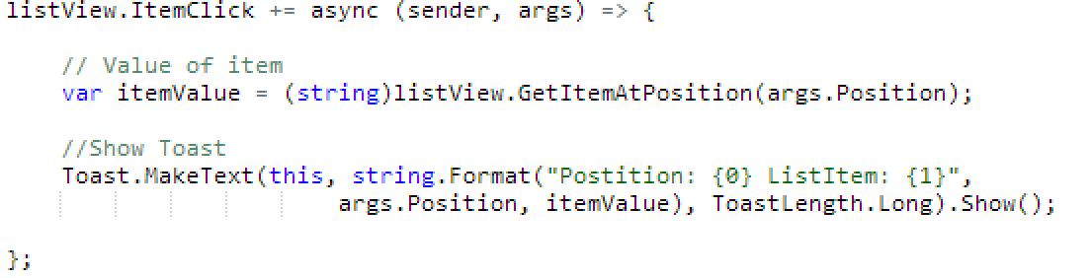
See the Difference – Android ItemClick
Java
C# with Xamarin
C# & Async with Xamarin
Notes:
Here we can see how easy it is just to do a += for an event and not have to implement a bunch of listeners every time. Easy to read, string.Format, using args, etc.
In fact we can make this call Async/Await by just adding async to the delegate!

Slide 16
Windows APIs
Microsoft.Phone
Microsoft.Networking
Windows.Storage
Windows.Foundation
Microsoft.Devices
System.Net
System
System.IO
System.Linq
System.Xml
System.Data
System.Windows
System.Numerics
System.Core
System.ServiceModel
Notes:
If you have ever developed for a Windows Platform before these .NET namespaces might look familiar.
However, if we go to a new platform such as Windows Phone or Store we have a new SDK to use and a new set of namespaces.

Slide 17
iOS – 100% API Coverage
MapKit
UIKit
iBeacon
CoreGraphics
CoreMotion
System.Net
System
System.IO
System.Linq
System.Xml
System.Data
System.Windows
System.Numerics
System.Core
System.ServiceModel
Notes:
You can think of iOS and Android development the same with Xamarin. You can see we have all of our .NET namespaces and libraries, but Xamarin give us 100% api coverage of each iOS API in it’s SDK that we access view C#.

Slide 18
Android – 100% API Coverage
Text-to-speech
ActionBar
Printing Framework
Renderscript
NFC
System.Net
System
System.IO
System.Linq
System.Xml
System.Data
System.Windows
System.Numerics
System.Core
System.ServiceModel
Notes:
The same is true for Android as well.

Slide 19
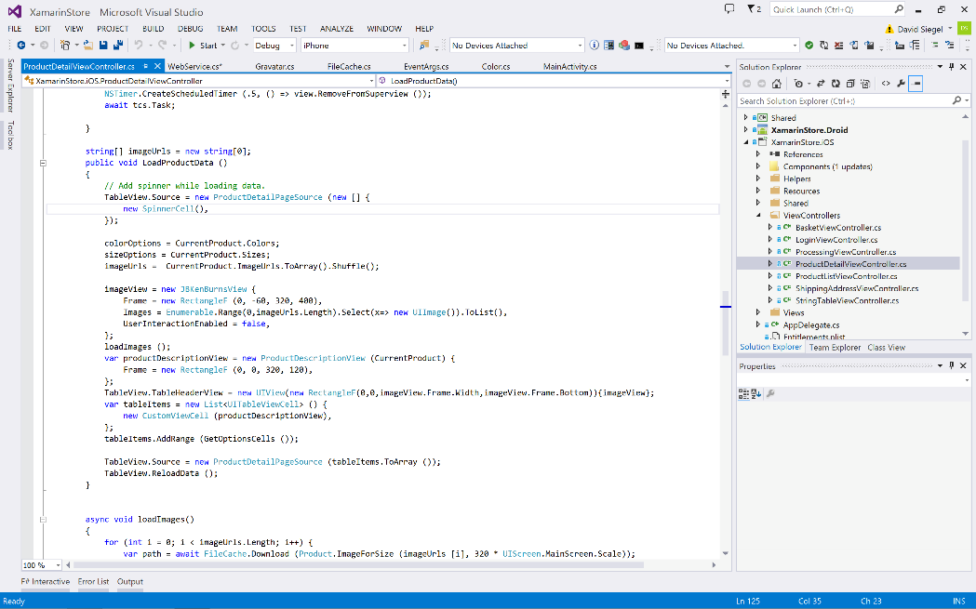
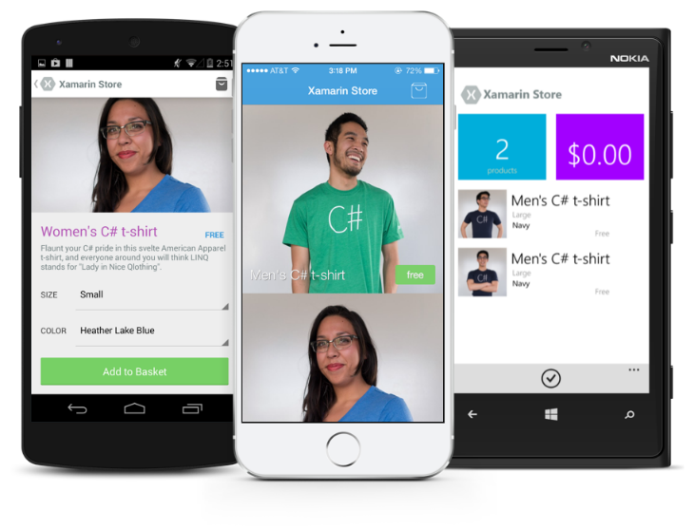
Anything you can do in Objective-C, Swift, or Java can be done in C# and Visual Studio with Xamarin.

Slide 20
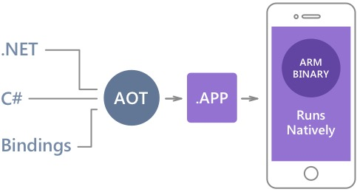
Native Performance
Xamarin.iOS does full Ahead Of Time (AOT) compilation to produce an ARM binary for Apple’s App Store.
Xamarin.Android takes advantage of Just In Time (JIT) compilation on the Android device.
Notes:
There is no compromise on performance.
Xamarin apps look and feel native because they are native.

Slide 21
✓Always Up-to-Date
Same-day support:
iOS 5
iOS 6
iOS 7
iOS 7.1
iOS 8
iOS 9
Full support for:
Apple Watch
Apple TV
Google Glass
Android Wear
Amazon Fire TV
and much more
Notes:
Apple has a developer preview where Xamarin has alphas ready. Google does not offer this.
Android versions are usually 4 to 8 weeks out for a stable release, but alphas and betas are usually earlier.
Xamarin realizes how important having iOS ready because within 24 hours a large portion of iOS users upgrade
Android on the other hand is much different. After 4 months on the market Android 4.4 only had 1% adoption

Slide 22
Sharing Code

Slide 23
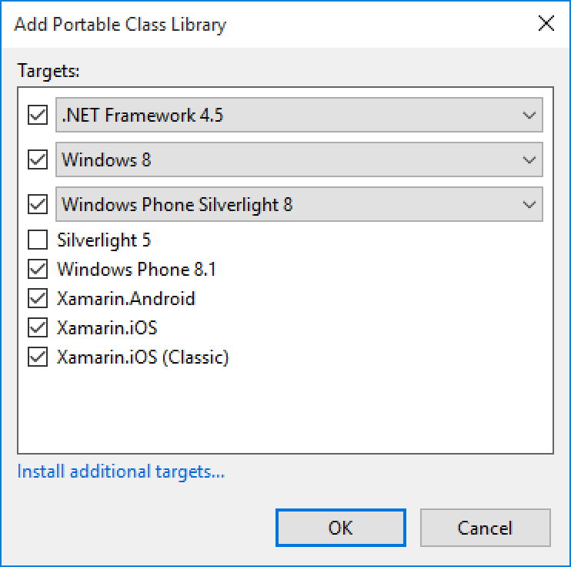
Portable Class Libraries
1 Assembly
Multiple Platforms
Including:
Xamarin.iOS and Xamarin.Android

Slide 24
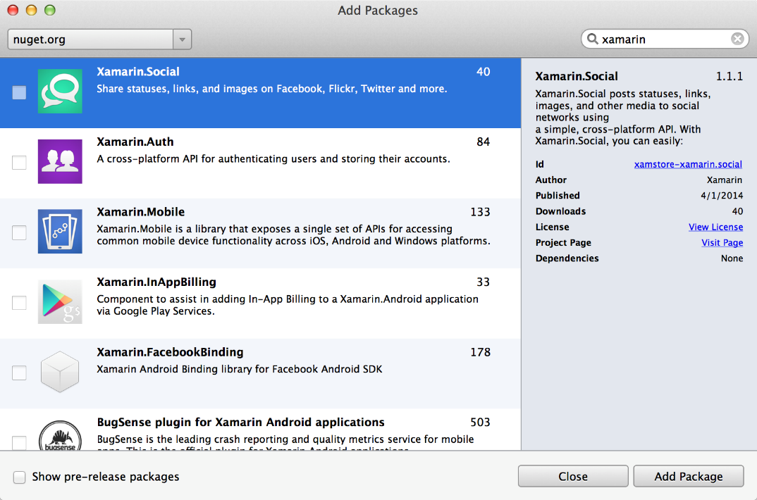
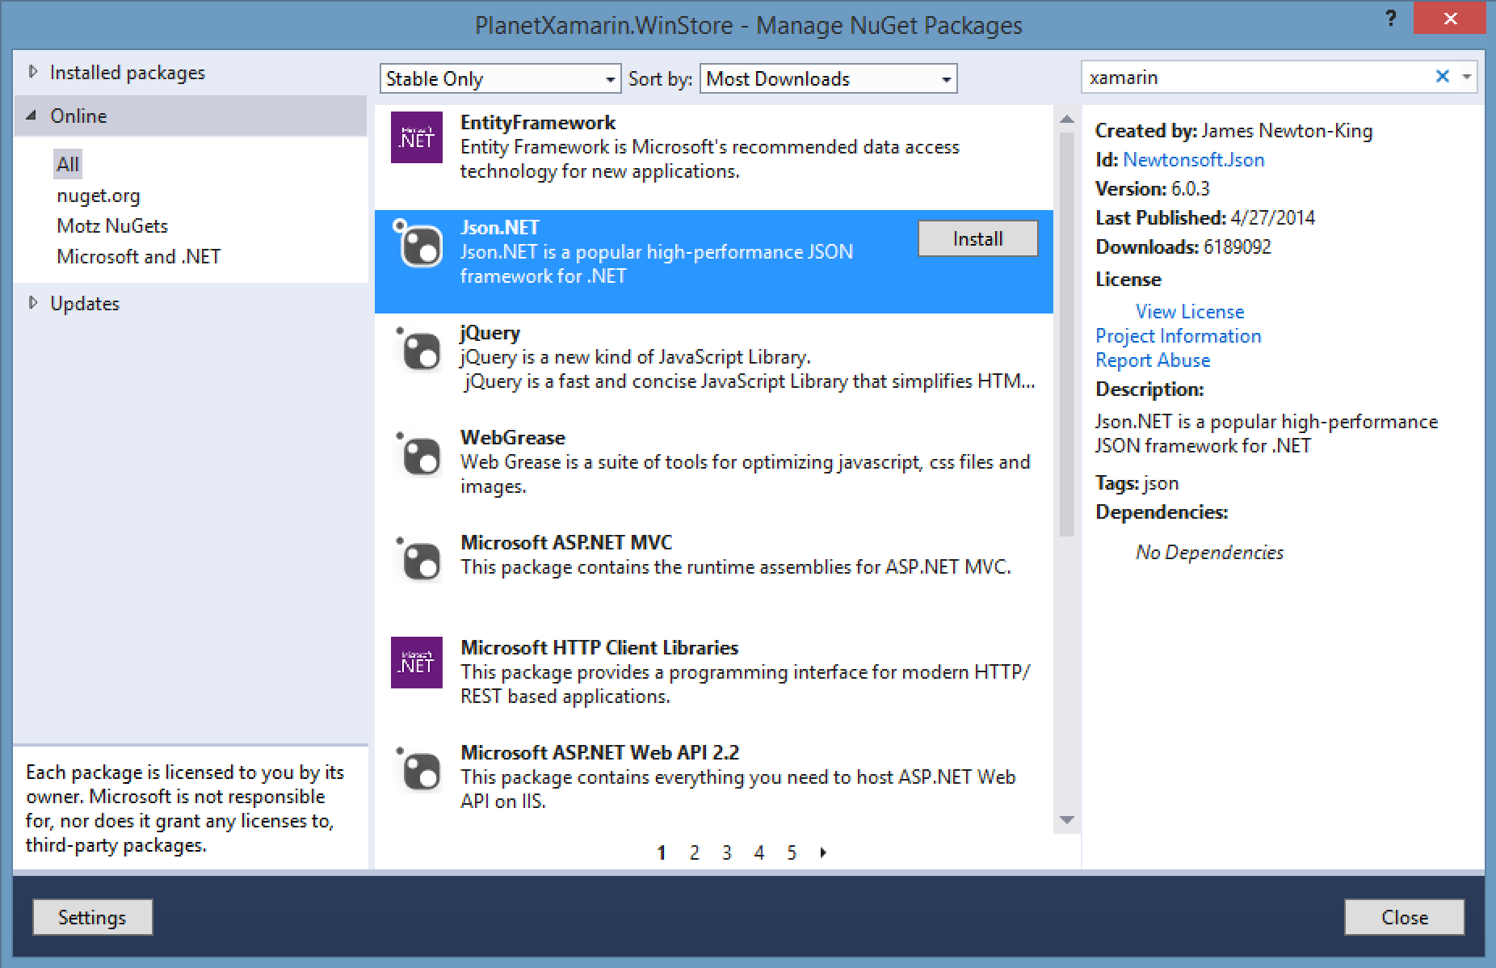
NuGet
Notes:
Use all of your favorite libraries from NuGet or share and distribute your own!

Slide 25
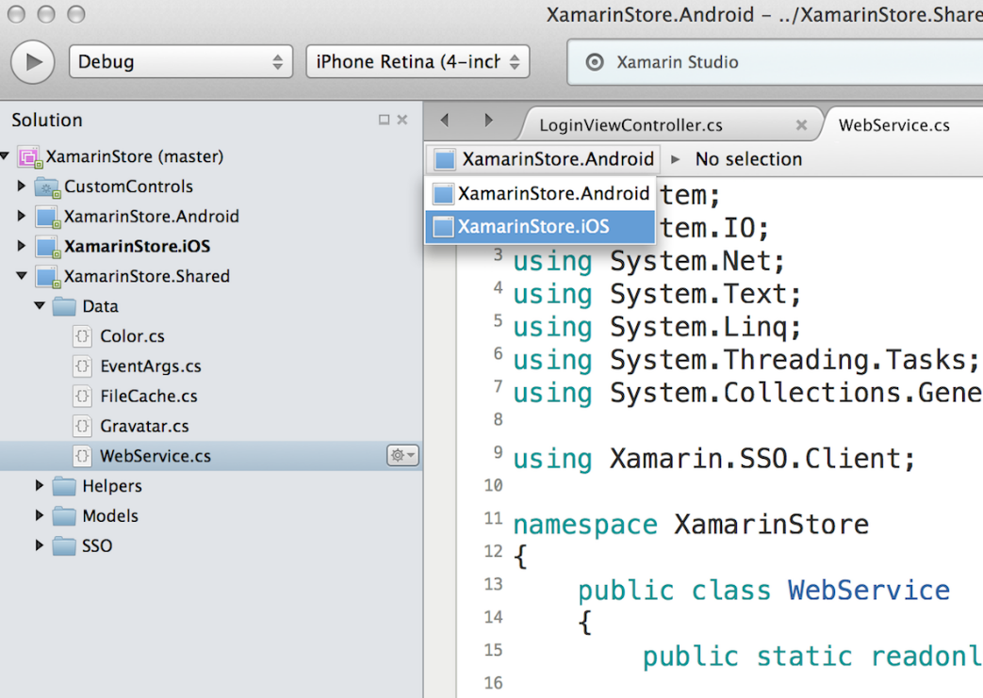
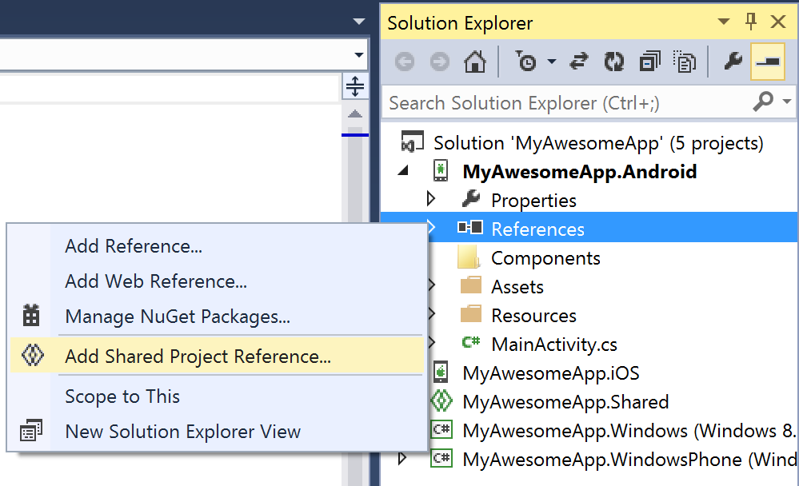
Shared Projects

Slide 26
Code Sharing Stats
iCircuit
Touch Draw
Android
iOS
Mac
Windows Phone
Notes:
iCircuit is made by Frank Krueger, a long time Mono & Xamarin developer.
Sharing code lead to 70 to 90% code reuse across platforms speeding up development
Real-time circuit simulator and editor used to design analog and digital circuits
http://praeclarum.org/post/42378027611/icircuit-code-reuse-part-cinq

Slide 27
Development Experience

Slide 28

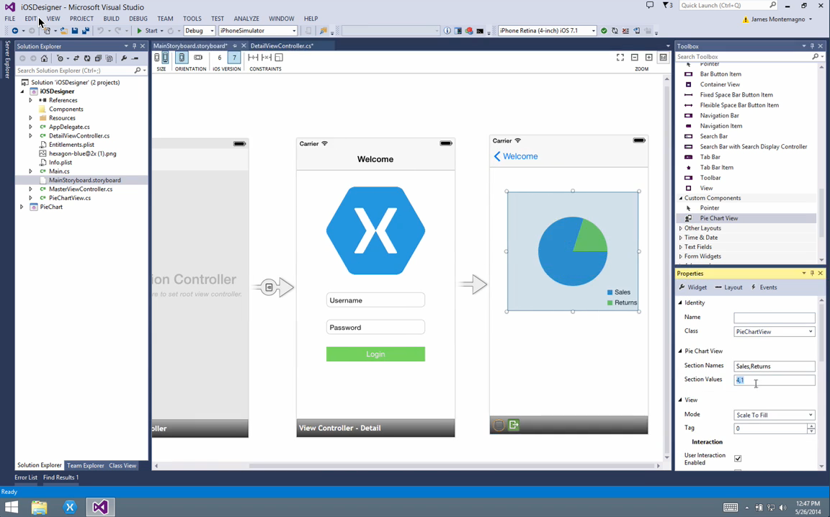
Visual Studio Integration
Notes:
Single Solution for iOS, Android, and Windows
Leverage Entire Microsoft Ecosystem:
ReSharper
Team Foundation Server
Azure
ASP.NET
Favorite Code Coverage and Profiling Tools
Starter Compatible
Visual Studio 2012, 2013, and 2015 including Community Edition

Slide 29
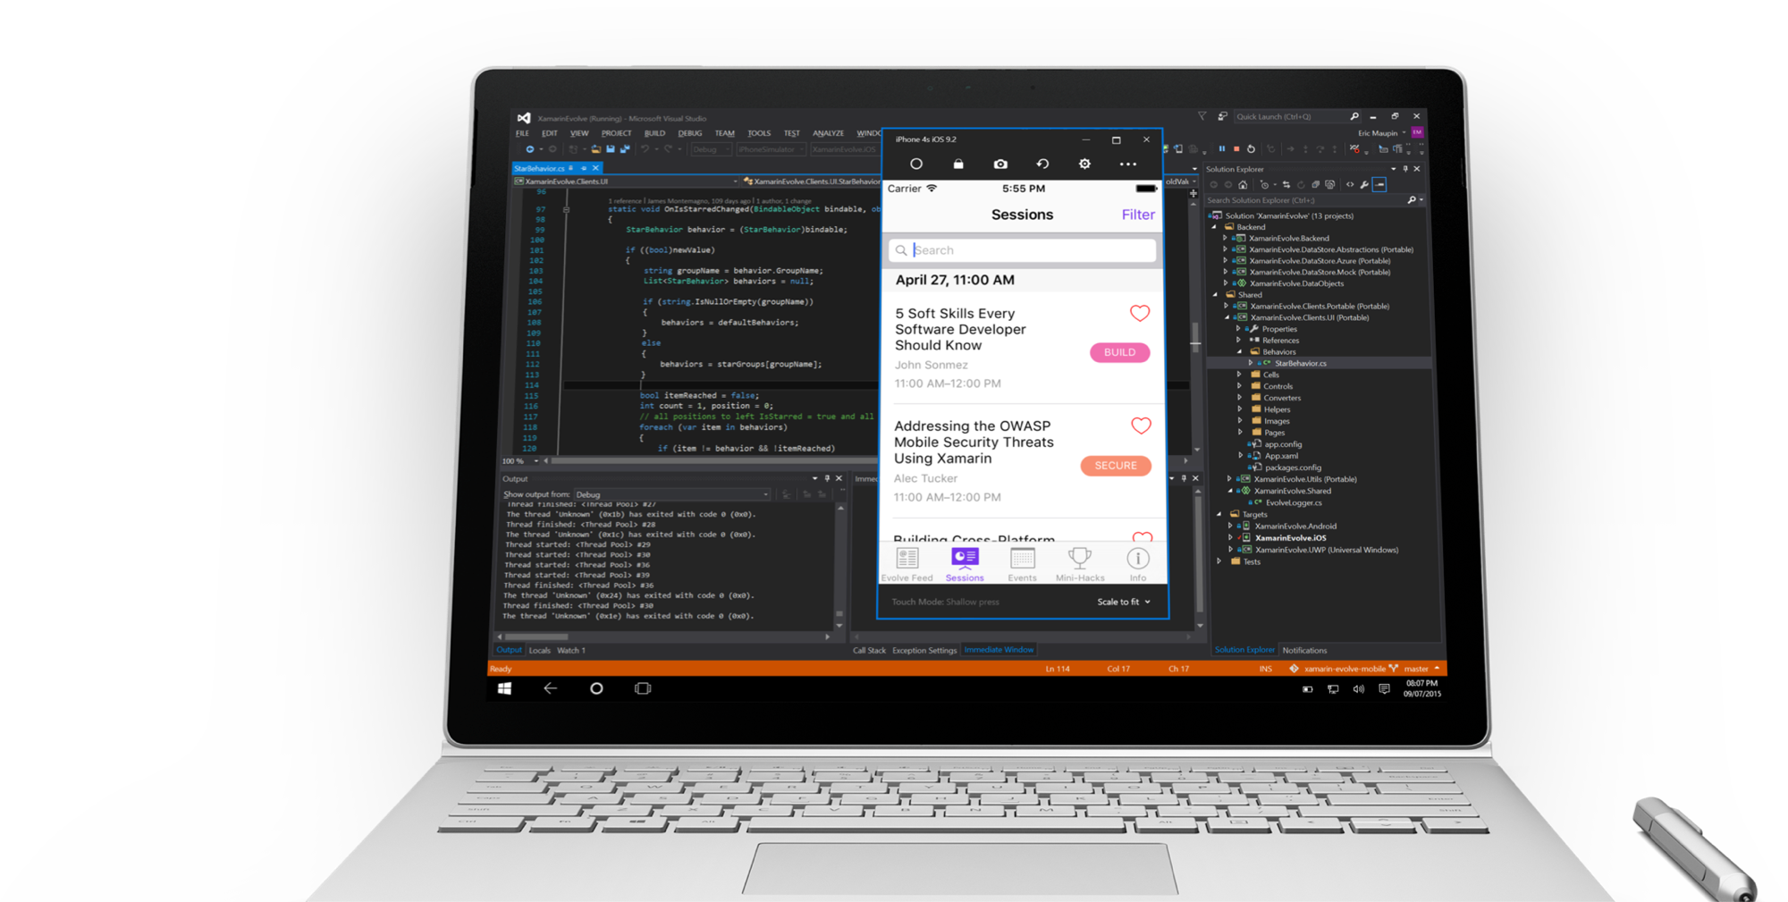
Visual Studio iOS Simulator Remoting
Multi-Touch Enabled
Pressure Sensitive
Super Fast
Rotate, screenshots, location changes
Never leave VS

Slide 30
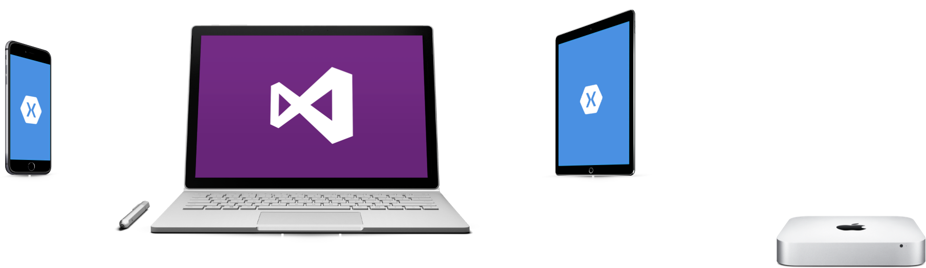
Visual Studio iOS USB Remoting
Notes:
Plug your iOS device into your PC
USB port is automatically remoted to your Mac.
Never leave your PC

Slide 31
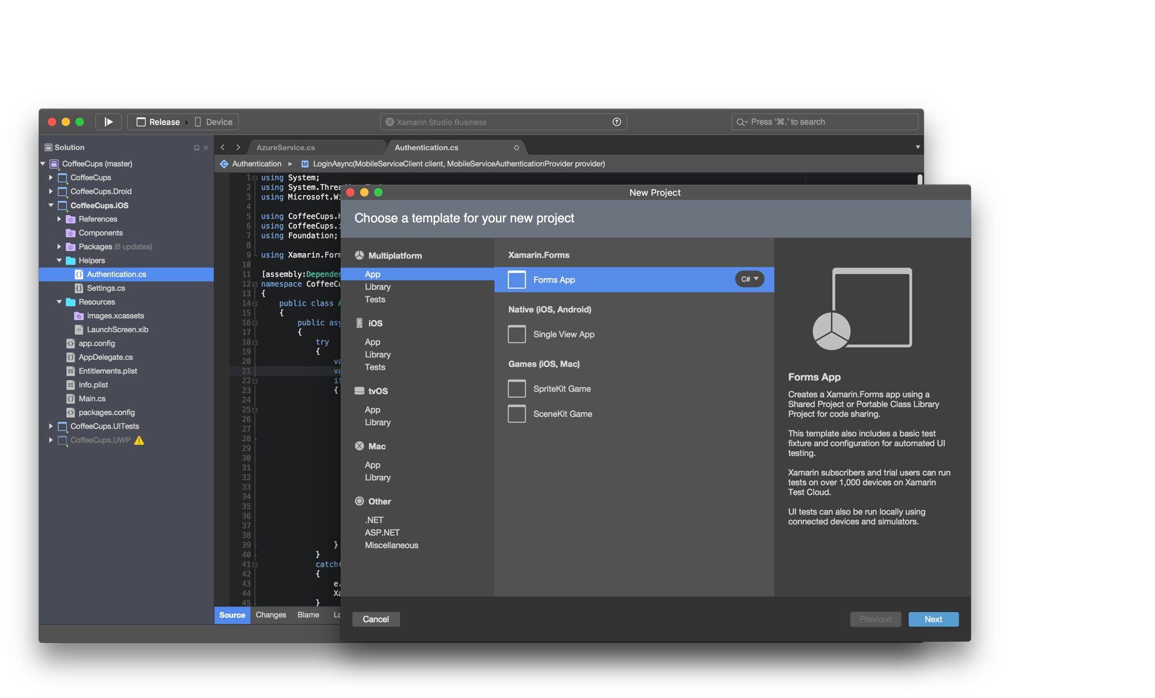
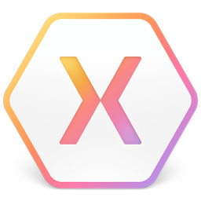
Xamarin Studio – Mac
Notes:
Xamarin Studio on Mac offers: Android, iOS and Mac development
World Class IDE with great features:
Code Analysis
Upload to Test Flight
Git & Subversion Integration
Code Completion
Code Navigation
Easy transition from Visual Studio
The same Solution & Projects open in BOTH Xamarin Studio and Visual Studio!

Slide 32
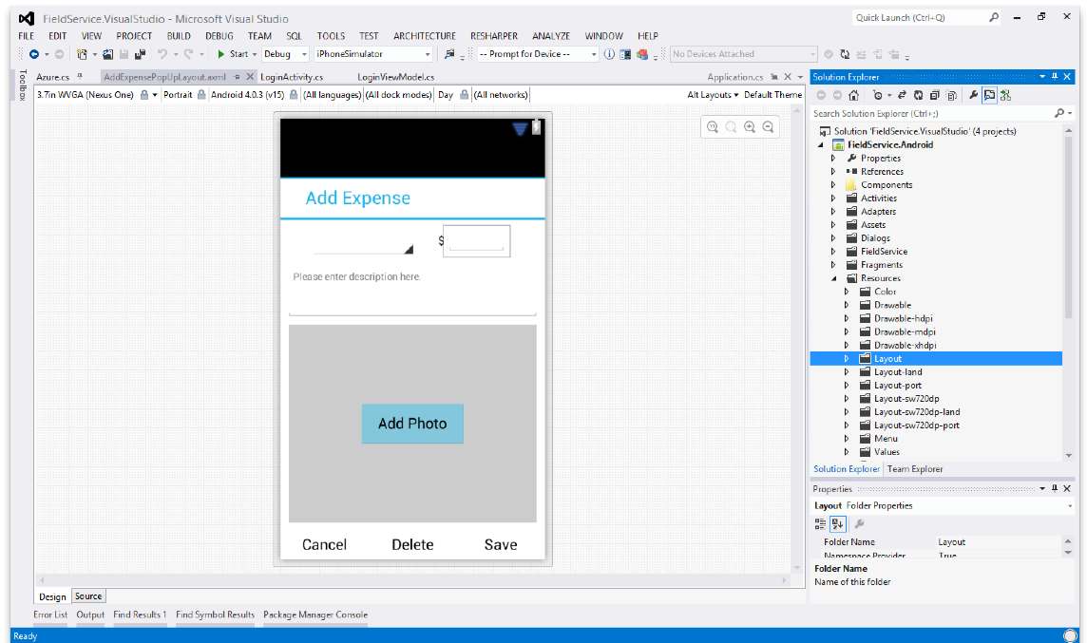
Android Designer
Available in:
Xamarin Studio
Visual Studio
Create UI with drag & drop simplicity
Target multiple screen sizes, resolutions and Android versions
Layouts saved in standard Android XML files

Slide 33
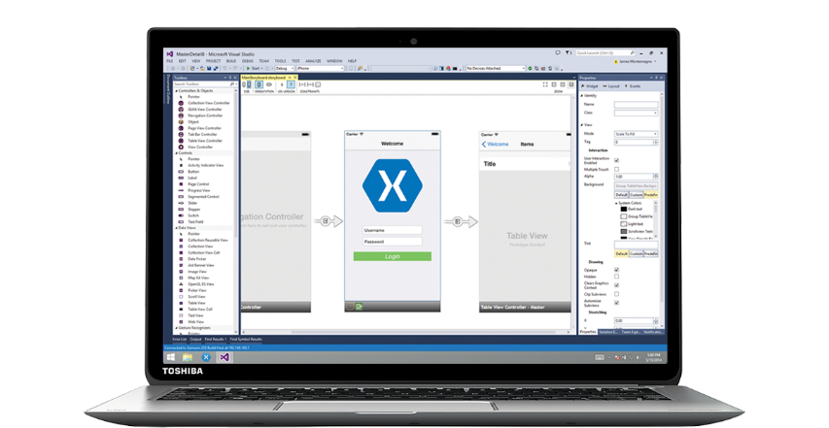
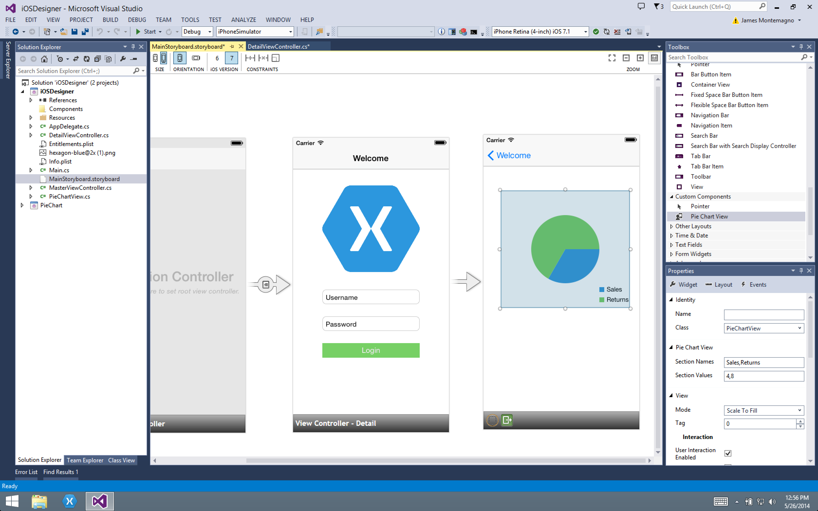
Xamarin Designer for iOS
World’s first iOS Designer available in Xamarin Studio and Visual Studio
Follows familiar Visual Studio designer idioms
Supports all UIKit elements
Edit custom and 3rd party components
Live preview of changes to properties

Slide 34
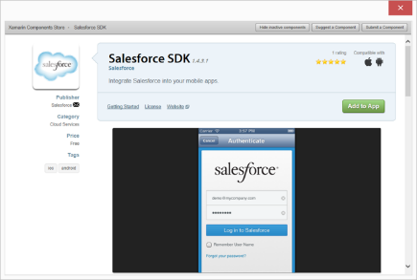
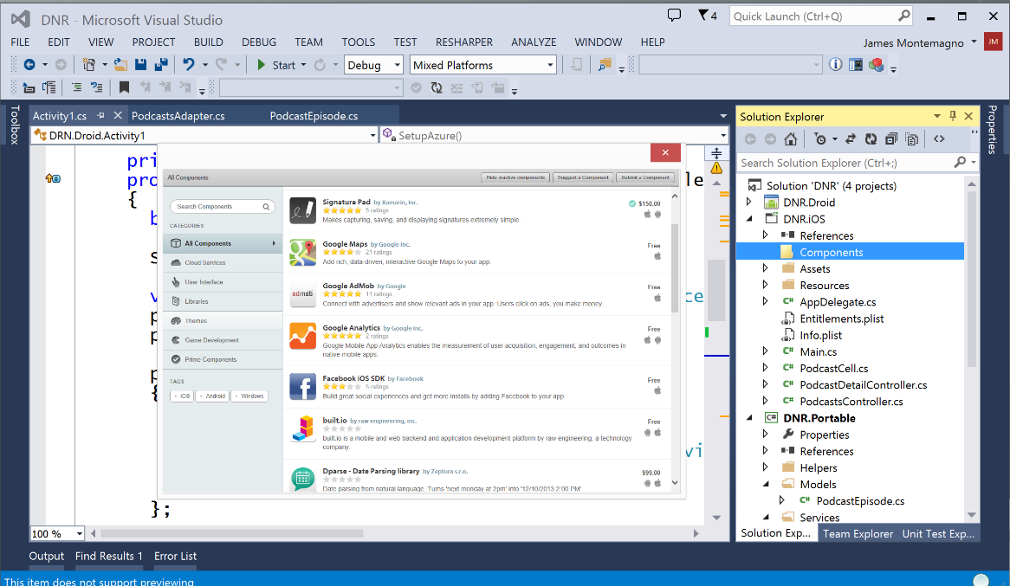
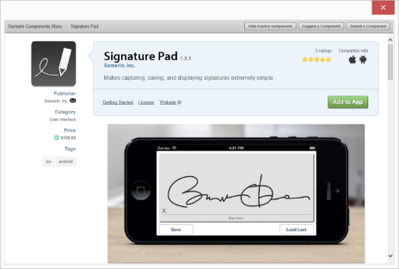
Xamarin Component Store
Build Apps Faster
Add high quality pre-built app components directly from Visual Studio and Xamarin Studio
Beautiful, cross-platform UI controls, cloud services, and enterprise backend integrations are just a few clicks away

Slide 35
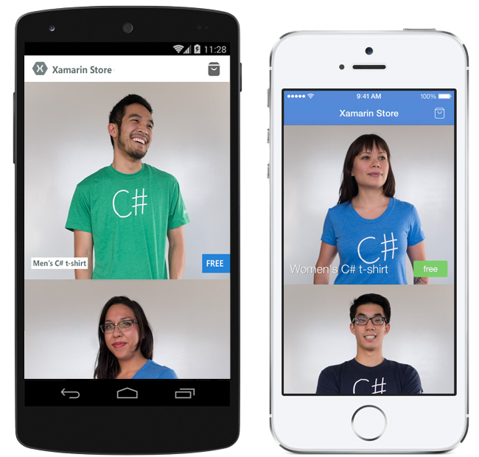


Pre-built App Templates
Xamarin.com/prebuilt
My Shoppe
Connect with consumers
Store Application
Moments
Photo Sharing App
Notes:
If you are looking to get started will a full baked application simply head over to Xamarin’s pre-built page featuring these apps and many more!

Slide 36
Let’s take a look

Slide 37
Meet Xamarin.Forms
Build native UIs for iOS, Android, and Windows Phone from a single, shared C# codebase.
Notes:
Xamarin Forms is a new set of APIs allowing you to quickly and easily write shared User Interface code that is still rendered natively on each platform, while still providing direct access to the underlying SDKs if you need it.

Slide 38
Xamarin + Xamarin.Forms
iOS C# UI
Android C# UI
Windows C# UI
Shared UI Code
Shared C# Backend
Shared C# Backend
Traditional Xamarin Approach
With Xamarin.Forms: More code-sharing, all native
Notes:
We see here the Xamarin approach we talked about earlier
This enables you to be highly productive, share code, but build out UI on each platform and access platform APIs
With Xamarin.Forms you now have a nice Shared UI Code layer, but still access to platform APIs
You can start from native, pick a few screens, or start with forms, and replace with native later

Slide 39
What’s included
✓ 40+ Pages, layouts, and controls
(Build from code behind or XAML)
✓ Two-way data binding
✓ Navigation
✓ Animation API
✓ Dependency Service
✓ Messaging Center
Shared UI Code
Shared C# Backend
Notes:
Xamarin.Forms is much more that just a framework and includes everything you need to get up and running to build out full native applications.
If you are used to MVVM type of development you will feel right at home.

Slide 40

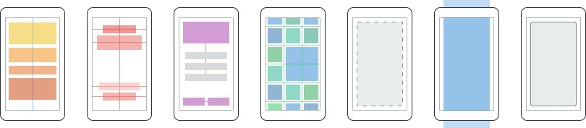
Layouts
Pages
Content
MasterDetail
Navigation
Tabbed
Carousel
Stack
Absolute
Relative
Grid
ContentView
ScrollView
Frame
Notes:
First you have a set of pages for each screen of your application
There are things like Content, and MasterDetail which gives you a nice flyout
With a tabbed view you get the correct look on each platform
iOS on bottom, Android on top, and on WP you have a Pivot control
Inside of a page are layouts
A lot of options from something simple like a stack panel to complex and powerful grids

Slide 41
Controls
ActivityIndicator
BoxView
Button
DatePicker
Editor
Entry
Image
Label
ListView
Map
OpenGLView
Picker
ProgressBar
SearchBar
Slider
Stepper
TableView
TimePicker
WebView
EntryCell
ImageCell
SwitchCell
TextCell
ViewCell
Notes:
You have more than 40 controls, layouts, and pages to mix and match from.
These are all of the controls you have out of the box, you can of course create your own.
What is unique is you get the native control and have access to it.
Consider an Entry Field
On iOS it is mapped to UITextField
Android it is EditText
Windows Phone it is a TextBox

Slide 42
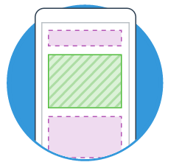
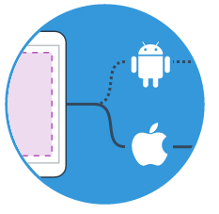

Extensibility
Embed Custom Views Anywhere
Not only are Xamarin.Forms pages mixable with custom screens, you can embed custom views built directly against Xamarin.iOS and Xamarin.Android into Xamarin.Forms pages.
Call Platform APIs via Shared Services
Need platform-specific functionality within a Xamarin.Forms page, such as querying the accelerometer? We’ve included services that quickly and easily abstract platform-specific API calls to keep you writing as much shared code as possible.
Easy migration to the Xamarin Platform
When your native platform integration requirements outgrow Xamarin.Forms, your shared code is easily migrated to Xamarin.iOS and Xamarin.Android using the full Xamarin platform.
Notes:
With Xamarin.Forms you can easily extend and embed custom views, mix and match screens, called native apis, or even easily migrate to a traditional app and share your backend logic.

Slide 43


Xamarin.Forms Ecosystem
Notes:
Xamarin.Forms also has a great ecosystem of controls from vendors you might know!

Slide 44
Control Comparison
Windows | Xamarin.Forms
StackPanel | StackLayout
TextBox | Entry
ListBox | ListView
CheckBox | Switch
ProgressBar | ActivityIndicator
Grid | Grid
Label | Label
Button | Button
Image | Image
Date/TimePicker | Date/TimePicker

Slide 45
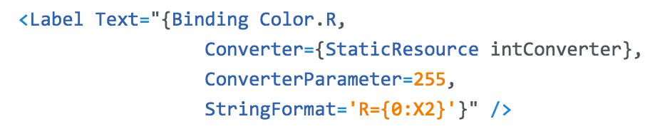
Binding Comparison
Windows | Xamarin.Forms
DataContext | BindingContext
{Binding Property} | {Binding Property}
ItemsSource | ItemsSource
ItemTemplate | ItemTemplate
DataTemplate | DataTemplate

Slide 46
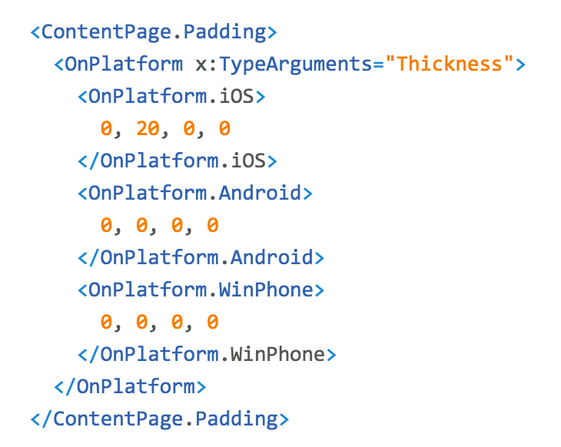
Platform Customization

Slide 47
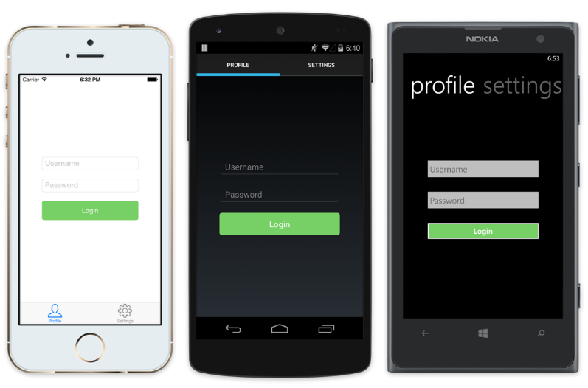
Native UI from shared code
<?xml version="1.0" encoding="UTF-8"?>
<TabbedPage xmlns="http://xamarin.com/schemas/2014/forms"
xmlns:x="http://schemas.microsoft.com/winfx/2009/xaml"
x:Class="MyApp.MainPage">
<TabbedPage.Children>
<ContentPage Title="Profile" Icon="Profile.png">
<StackLayout Spacing="20" Padding="20"
VerticalOptions="Center">
<Entry Placeholder="Username"
Text="{Binding Username}"/>
<Entry Placeholder="Password"
Text="{Binding Password}"
IsPassword="true"/>
<Button Text="Login" TextColor="White"
BackgroundColor="#77D065"
Command="{Binding LoginCommand}"/>
</StackLayout>
</ContentPage>
<ContentPage Title="Settings" Icon="Settings.png">
<!-- Settings -->
</ContentPage>
</TabbedPage.Children>
Notes:
Here is a quick example of a login page:
Notice the data binding on the Entries Text fields. Additionally, there is a LoginCommand.
Each has a native user interface

Slide 48
Let’s Take a Look

Slide 49
What’s new?

Slide 50
XAML Previewer

Slide 51
DataPages
https://developer.xamarin.com/guides/xamarin-forms/datapages/

Slide 52
Themes
https://developer.xamarin.com/guides/xamarin-forms/themes/

Slide 53
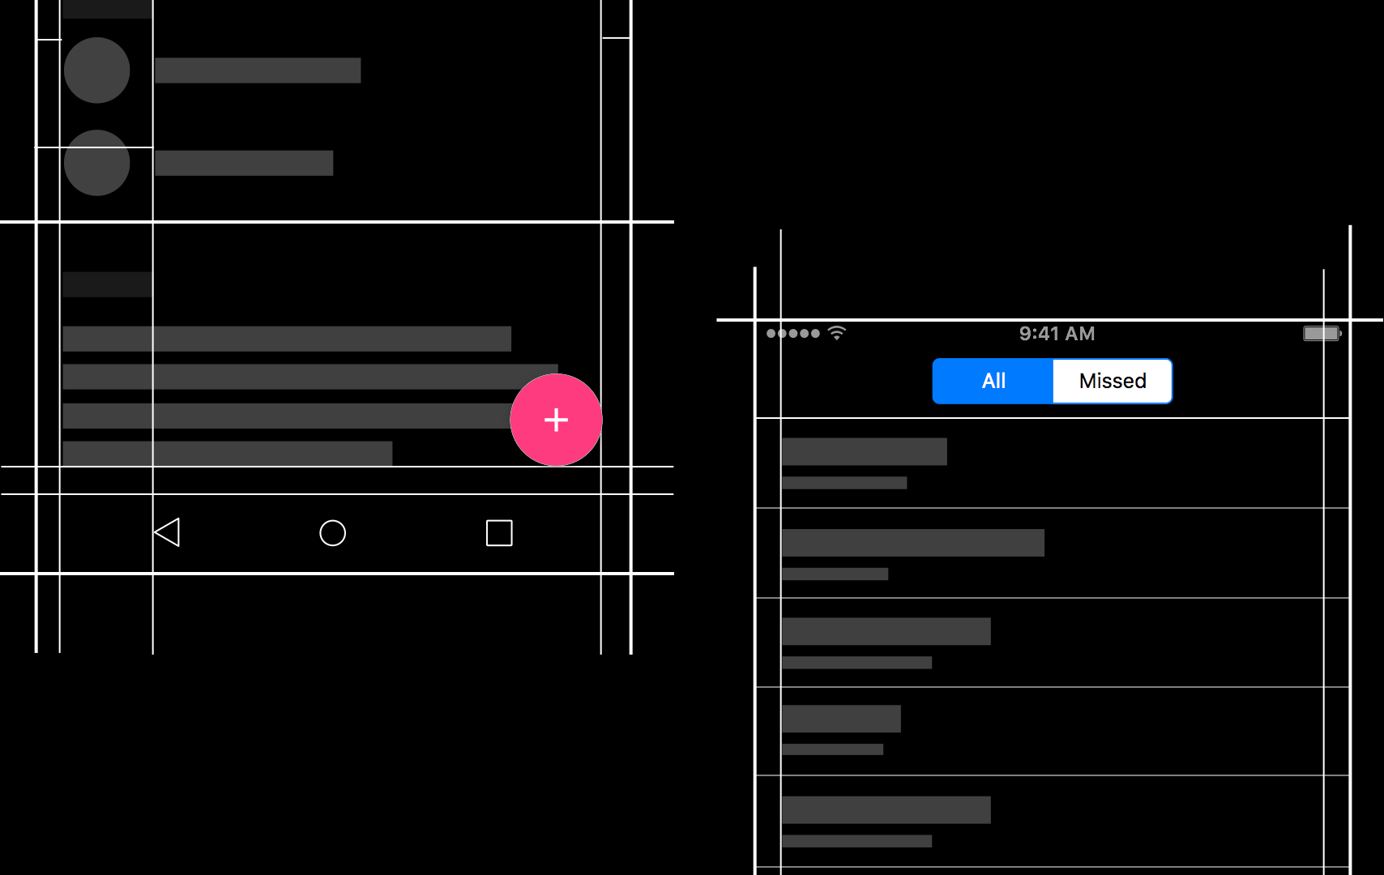
Native Embedding
Notes:
Easily embed any native control into a Xamarin.Forms layout.

Slide 54
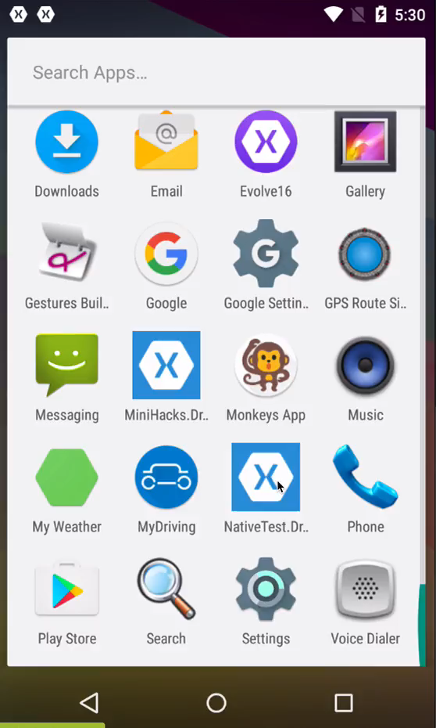
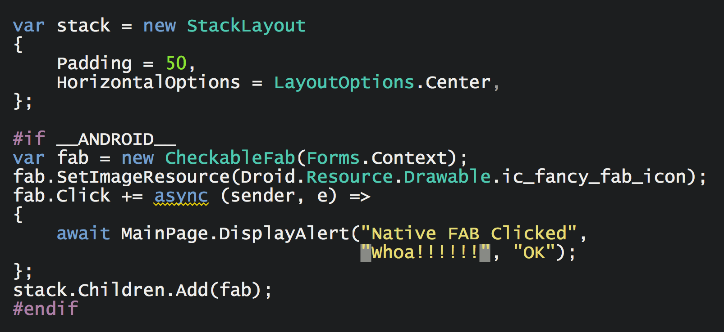
Native Embedding
Notes:
Just add it as child to a layout.
Exposed as an Extension Method.

Slide 55
Plugins for Xamarin
Notes:
A unique aspect of Xamarin.Forms is an abstraction over the user interface, but what about the platform specific functionality that makes these devices so special?
That is where plugins for Xamarin come in.

Slide 56
Shared C# Backend
Notes:
What is this stuff that we talk about up here?

Slide 57
Platform Specific Code
UI+APIs
UI + APIs
UI + APIs
Battery
GPS
Lights
Notifications
Settings
Text To Speech
Battery
GPS
Lights
Notifications
Settings
Text To Speech
Battery
GPS
Lights
Notifications
Settings
Text To Speech
What if we didn’t have to write this code?
What if we could access it from shared code?
Notes:
This is the platform specific code no matter how you are developing traditional Xamarin or with Xamarin.Forms.
However, many platform APIs are the same bit of functionality, but with different APIs.
What if we had 1 API?

Slide 58
Speak(“Hello World”);
AVSpeechSynthesizer
TextToSpeech
SpeechSynthesizer
Notes:
For instance text to speech, what if we could just say “Speak” and it would speak text with the underlying API.

Slide 59
Plugins for Xamarin
github.com/xamarin/plugins
Common API
Notes:
This is what Plugins for Xamarin are for! 1 API for all common APIs:
Camera
GPS
Settings
Notifications
Battery
And so much more!

Slide 60
Let’s Take a Look

Slide 61

Test
Notes:
Xamarin is your complete mobile solution.
Xamarin Platform is usually what you hear about which is building native iOS, Android, Mac, and Windows Apps all in C#
However Xamarin offers a wide range of products for developers to go mobile including Test Cloud, Hockey App, and a way to learn all of mobile with University.

Slide 62
Device Fragmentation
App Complexity
Fast Release Cycles
Short Sessions
High Mobile User Expectations
Challenges
Notes:
Well there are several challenges that we must overcome as mobile developers including….

Slide 63
On Mobile, Quality is Hard
5
20
20
35
6
OS versions
Devices
Languages
Locales
Screen sizes
9
19K+
39
57
27
15
6
OS versions
Distinct devices
Languages
Locales
Screen sizes
Manufacturers
Screen configurations
8
Notes:
First let’s take a look at the shear number of configurations there are between iOS and Android. As iOS progresses this number is only set to increase, and on Android it is already a HUGE number of configurations to even think about testing.
iOS: 7, 7.1, 8, 8.1, 8.2

Slide 64
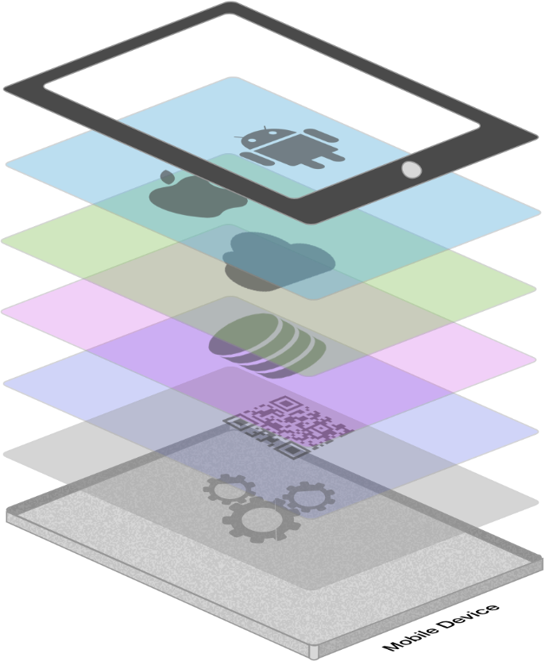







App Complexity
Thousands of iOS and Android APIs
Public web APIs
Backend integrations
Third party libraries
Memory, CPU and network constraints
Notes:
The fragmentation isn’t just in the devices, but as we start to build on our applications you soon found out they are ever increasingly complex.

Slide 65








Tap
Scroll
Swipe
Pinch
Multi Finger
Text Entry
Rotation
GPS
Notes:
With a simple command you can simulate all of your users interactions to build out a great test suite that can be run over and over again.

Slide 66
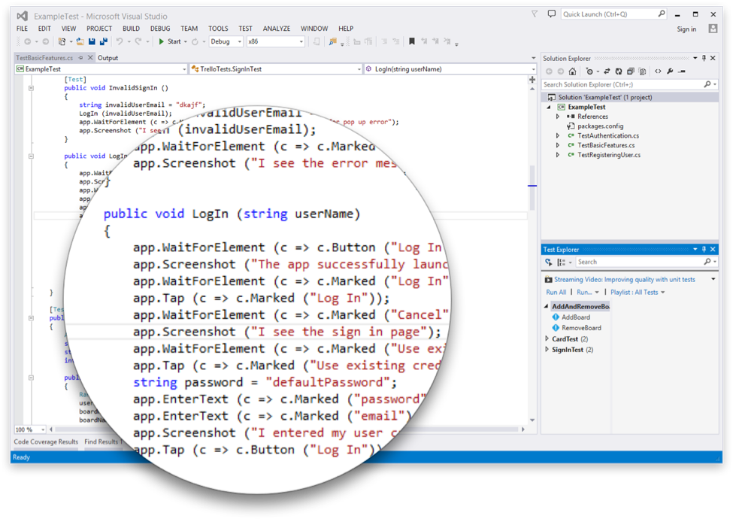
Introducing Xamarin.UITest
Create Automated User Interface tests all in C#
Upload to the Test Cloud or run against a Device or Simulator
Run directly from Visual Studio or Xamarin Studio
Freely available for testing on a Simulator*
Works on ANY app: Native, Hybrid, or Xamarin
Notes:
This is where Xamarin.UITest comes in to help with this shift. Xamarin.UITest is a framework that ties in directly to the Nunit testing framework to write the UI tests. You can even run them directly against a simulator for free to do regression tests on your applications.
Freely available for testing on a Simulator*

Slide 67

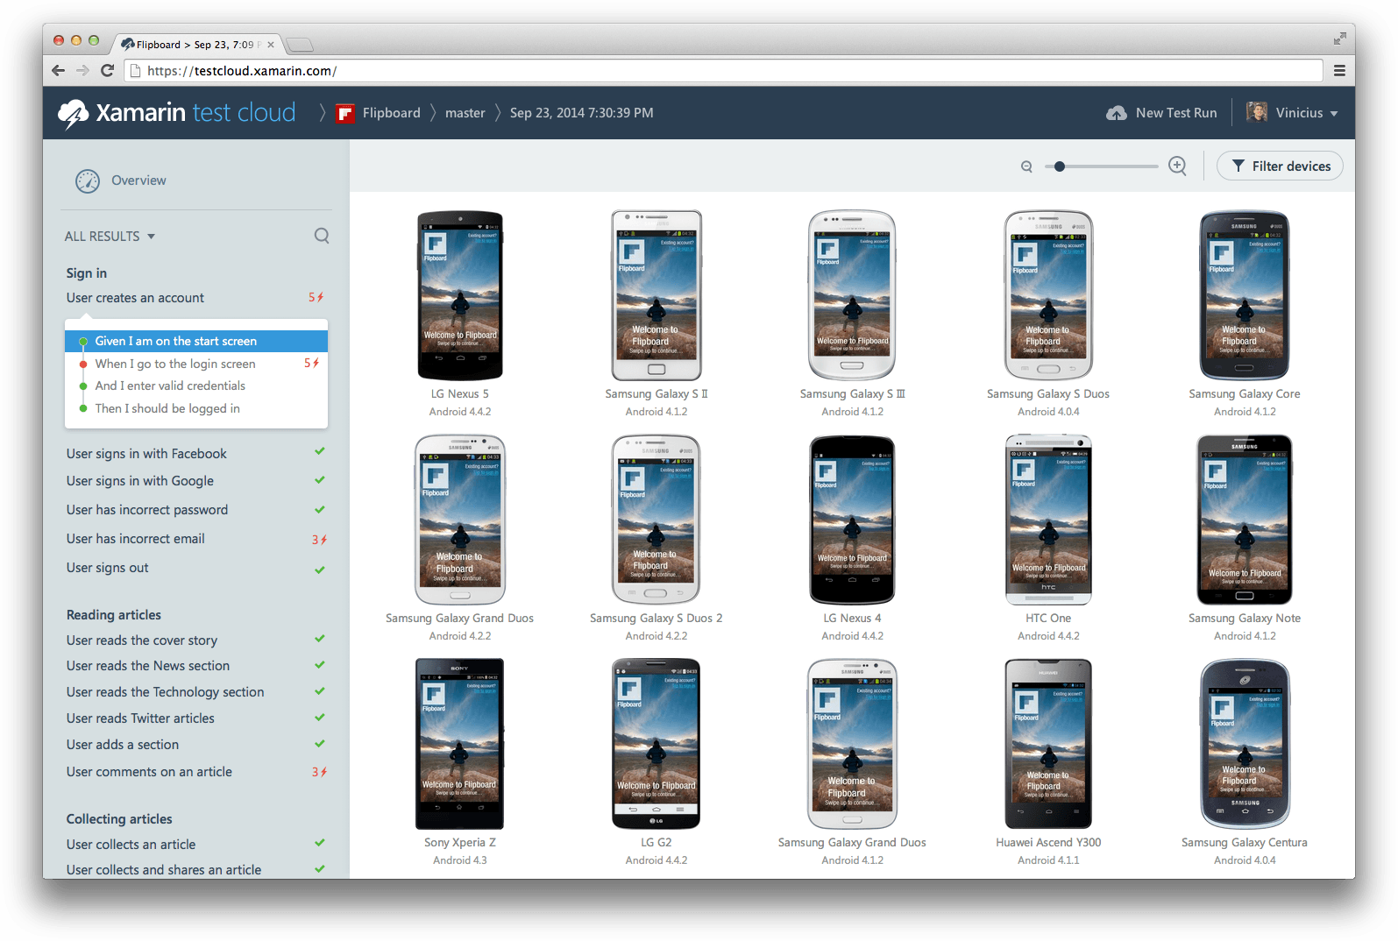
xamarin.com/testcloud
Notes:
Take test scripts and test again thousands of physical devices!
All Xamarin subscribers get free device time! Check store.xamarin.com for details.

Slide 68
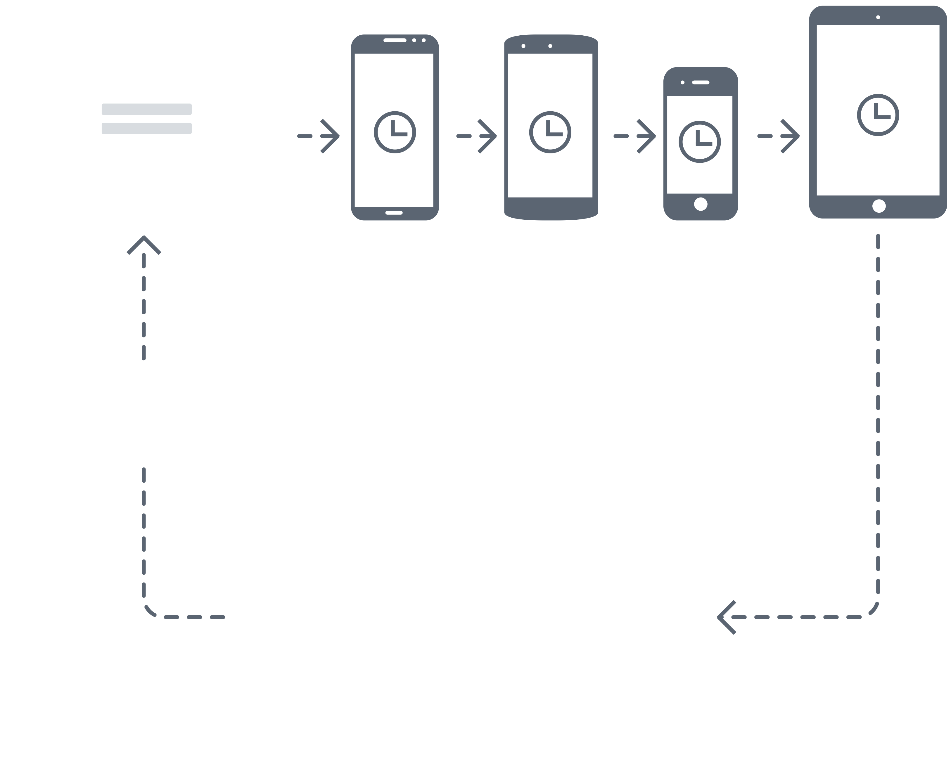
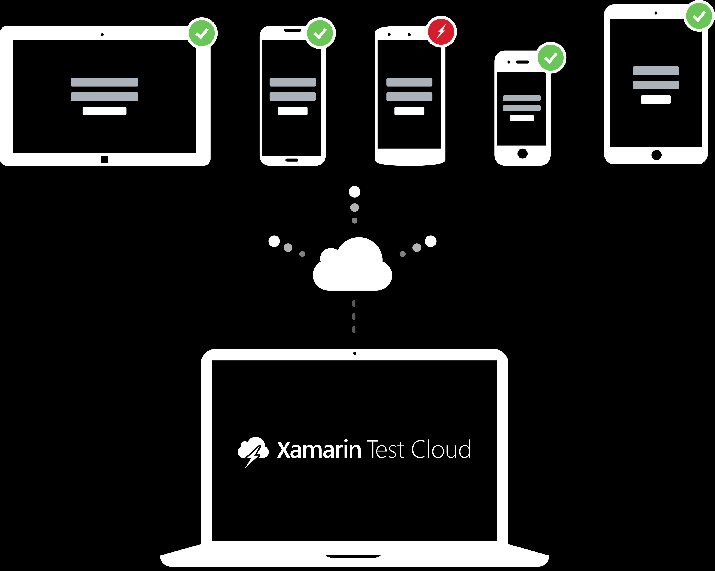

Approaches to Mobile Testing
Device Remoting
Tests are performed one at the time, which consumes more time and delays bugs detection
Automated Testing
Test on thousands of devices simultaneously,
saving lots of time and detecting
bugs more quickly
Notes:
Approaches to Mobile Testing

Slide 69
Thank You! Questions?
Presenter
Name
Title
email
blog
twitter

